Slide 1
Design Concept
By Andre Alexandrov
ITWorks

Slide 2
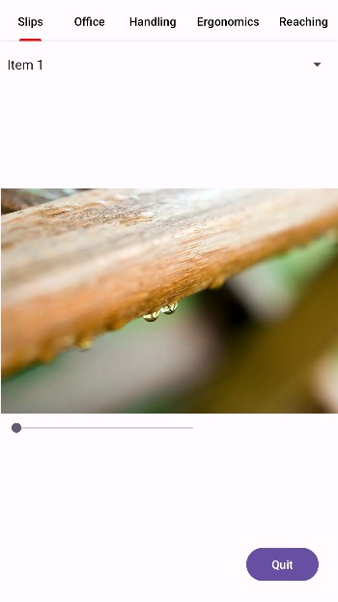
Concept interfaces

Slide 3
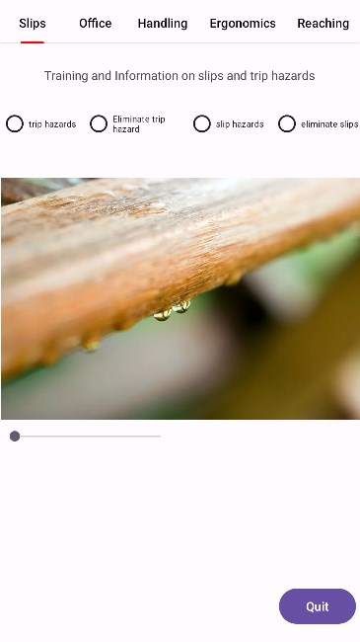
Concept interfaces

Slide 4
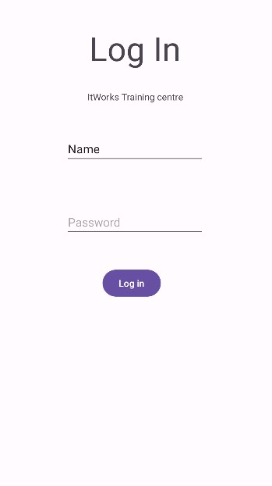
Log in Screen

Slide 5
Information on what is a slip hazard

Slide 6
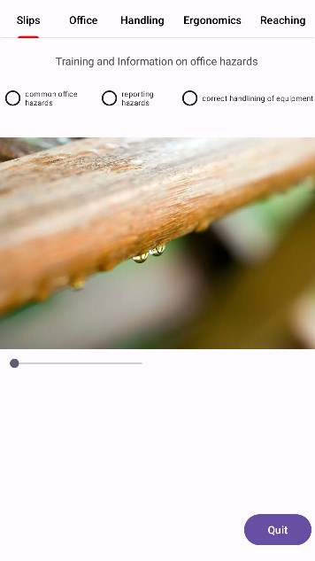
Training and Information on office hazards

Slide 7
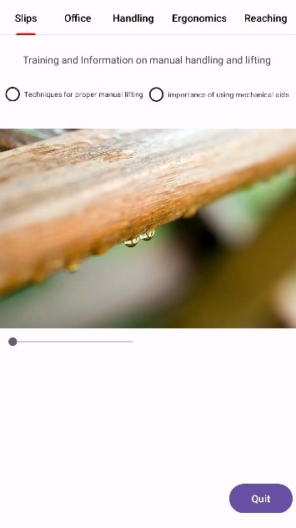
Training and Information on manual handling and lifting

Slide 8

Training and Information on office ergonomics

Slide 9
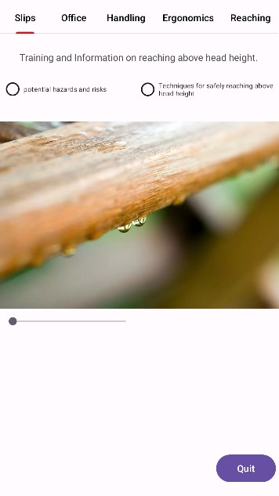
Training and Information on reaching above head height

Slide 10
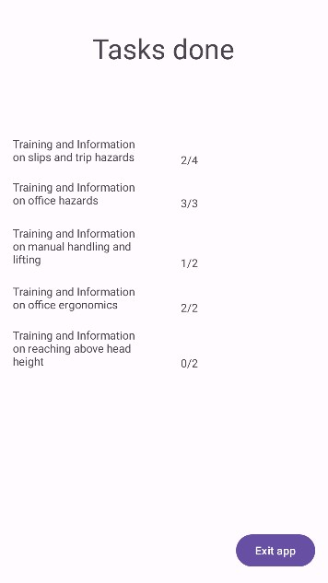
Completed tasks and results

